Slide 1
E-Retail Customer Activation and Retention
Amritesh Kumar
December 2021

Slide 2
Problem Overview
E-retail factors for customer activation and retention:
A case study from Indian e-commerce customers.
Customer satisfaction has emerged as one of the most important factors that guarantee the success of online store; it has been posited as a key stimulant of purchase, repurchase intentions and customer loyalty.
A comprehensive review of the literature, theories and models have been carried out to propose the models for customer activation and customer retention.
Five major factors that contributed to the success of an e-commerce store have been identified as: service quality, system quality, information quality, trust and net benefit.
The research furthermore investigated the factors that influence the online customers repeat purchase intention.
Combination of both utilitarian value and hedonistic values are needed to affect the repeat purchase intention (loyalty) positively. The data is collected from the Indian online shoppers.
Results indicate the e-retail success factors, which are very much critical for customer satisfaction.

Slide 3
Conceptual Background of the Domain Problem
MACHINE LEARNING AND DATA SCIENCE FOR BUSINESS:
Machine learning is a branch of artificial intelligence (AI) & computer science focusing on the use of data & algorithms to imitate the way that humans learn from experience, make predictions and gradually improving its accuracy. It is an important component of the growing field of data science.
Through the use of statistical methods, algorithms are trained to make classifications or predictions, uncovering key insights within data mining projects. These insights subsequently drive decision making within applications and businesses, ideally impacting key growth metrics.
As big data continues to expand and grow, the market demand for data science will increase, requires to assist in the identification of the most relevant business questions and subsequently the data to answer them. Following are the ways Data science can add value to Business :
• Empowering management and officers to make better decision
• Directing actions based on trends—which in turn help to define goals
• Challenging the staff to adopt best practices and focus on issues that matter
• Identifying opportunities
• Decision making with quantifiable, data-driven evidence
• Testing these decisions
• Identification and refining of target audiences

Slide 4
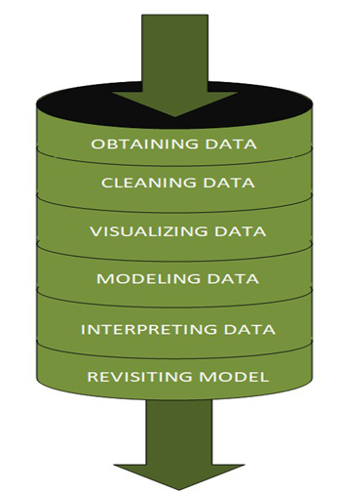
DATA SCIENCE PIPELINE:
The data science pipeline is a collection of connected tasks that aims at delivering an insightful data science product or service to the business organization.
The responsibilities include collecting, cleaning, exploring, modeling, interpreting the data, and other processes of the launching of the product.
“This final product can be used for to achieve Business Goals”
Exploratory Data Analysis (EDA) & IT’s TYPES:
The main purpose of EDA is to help look at data before making any assumptions.
It can help identify obvious errors, as well as better understand patterns within the data, detect outliers or anomalous events, find interesting relations among the variables.
Data scientists can use exploratory analysis to ensure the results they produce are valid and applicable to any desired business outcomes and goals.
EDA also helps stakeholders by confirming they are asking the right questions
TYPES OF EXPLORATORY DATA ANALYSIS:
Univariate Non-graphical
Multivariate Non-graphical
Univariate graphical
Multivariate graphical

Slide 5
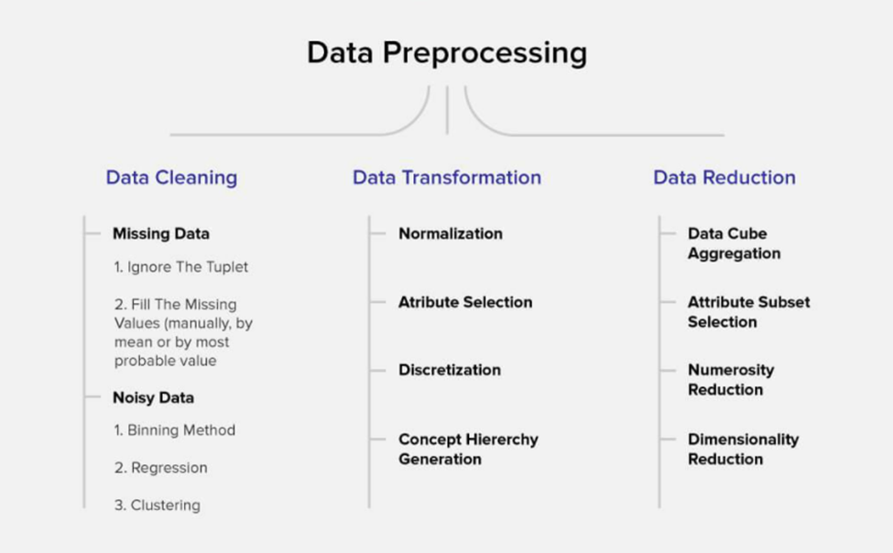
DATA PRE-PROCESSING
Data per-processing is a very vital input to machine learning models, It is to prepare the raw data & make it suitable for efficient machine learning model. These are the methods of data preprocessing and we are going to use the required ones in our project.

Slide 6
FEATURE ENGINEERING
Feature engineering is the process of selecting, manipulating & transforming raw data into features that can be used in supervised learning. In simple terms, is the act of converting raw observations into desired features using statistical or machine learning approaches. It can produce new features for both supervised and unsupervised learning, with the goal of simplifying and speeding up data transformations while also enhancing model accuracy
Techniques Used,
Imputation
Handling Outliers
Log Transform
One-hot encoding/Label Encoding
Scaling
Data Transformation:
Label Encoding:
In library installation, Label Encoder is used to encode labels by assigning them numbers. It is used to encode single or multiple columns. Thus, if the feature is color with values such as [‘white’, ‘red’, ‘black’, ‘blue’]., using Label Encoder may encode color string label as [0, 1, 2, 3]

Slide 7
Review of Literature
ABSTRACT:
E-retail has become the need of the hour for the modern customers nowadays. This project focuses on the key factors for customer activation & retention. Given data-set needs to be analyzed in order to understand the things gone wrong / right to formulate a strategy / layout key points towards the customer activation & retention
Business Goal:
We are required to analysis the India e-retail industry survey response data-set by bifurcating them into hedonistic & Utilitarian values. Understand various influential factors customer encounters during online purchase done on a e-retail platform. Understand the customer’s choice across various platform & layout the key indices which makes them to make repeated purchases on an certain e-retail platform.

Slide 8
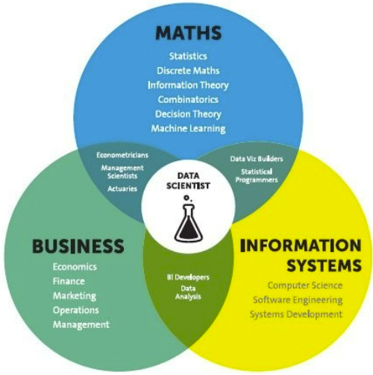
Analytical Problem Framing
Mathematical / Statistical / Analytical Modeling - are three of the most important concepts of Data Science. Data Science revolves around these three fields and draws their concepts to operate on the data.
Mathematical Modelling
Mathematical models are important, selecting the right one to answer the business question can bring tremendous value to the organization. It plays an essential role in the latest technologies like Machine Learning, Artificial Intelligence, Data Science and Deep Learning, etc., It is because every algorithm built in the latest technologies has a mathematical function behind it and aid in identifying patterns
The understanding of various notions of Statistics and Probability Theory are key for the implementation of such algorithms in data science.
Notions include: Regression, Maximum Likelihood Estimation, the understanding of distributions (Binomial, Bernoulli, Gaussian (Normal)) and Bayes’ Theorem
The main reason for a greater significance of mathematics is because of its various concepts like: –
Linear Algebra
Probability
Calculus – Differential & Integral Calculus
Statistics
Descriptive (Mean, Median, Mode, IQR, Std. deviation, Z & T- Statistics, linear regression)
Inferential (Sampling, Confidence interval, chi-square, ANOVA)

Slide 9
Analytical Problem Framing
Regression Models:
Data analysts use regression models to examine relationships between variables. Regression models are often used by organizations to determine which independent variables hold the most influence over dependent variables—information that can be leveraged to make essential business decisions
Classification Models:
Classification is a process in which an algorithm is used to analyze an existing data set of known points. The understanding achieved through that analysis is then leveraged as a means of appropriately classifying the data. Classification is a form of machine learning that can be particularly helpful in analyzing very large, complex sets of data to help make more accurate predictions.

Slide 10
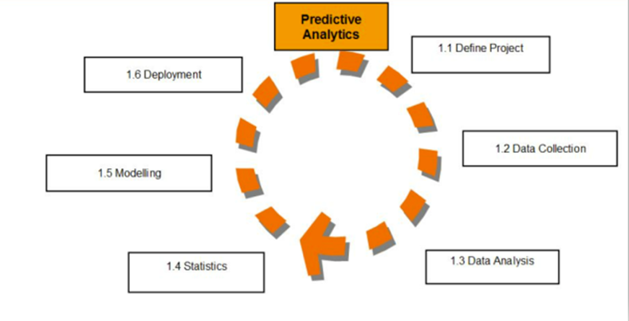
Analytical Models:
An analytical model is quantitative in nature, and used to
answer a specific question or make a specific design decision.
Different analytical models are used to address different aspects
of the system, such as its performance, reliability, or mass properties.
Data analysis comes with the fundamental types of data analytics
encounter in data science: Descriptive, Diagnostic, Predictive, and
Prescriptive.
Descriptive analytics is a statistical method that is used to search and summarize historical data in order to identify patterns or meaning.
Descriptive analysis is often used when reviewing any past or present data. This is because raw data is difficult to consume and interpret, while the metrics offered by descriptive analysis are much more focused.
The example of descriptive statistics or analytics is to calculate the mean, median mode, standard deviation, and similar kinds of statistical calculation on finance or sales data.
Diagnostic analytics takes it a step further to uncover the reasoning behind certain results. Diagnostic analytics is usually performed using such techniques as data discovery, drill-down, data mining, and different type of bivariant data analysis like correlations. etc.,
Predictive Analytics is a statistical method that utilizes algorithms and machine learning to identify trends in data and predict future behaviors. Predictive Analytics can take both past and current data and offer predictions of what could happen in the future.
Predictive models typically utilize variability in data to make the correct prediction and more variability of ingredient data that shows the relationship with what is possible to predict that united together into a prediction or valid score.
Prescriptive analytics automatically synthesizes big data, mathematical sciences, business rules, algorithms, and machine learning to make predictions and then suggests decision options to take advantage of the predictions. Prescriptive means (optimization and simulation).

Slide 11
Data Sources and their formats
Technical Requirements:
• Data contains 269 entries each having 71 variables.
• Data set doesn’t contains Null values. We treated them using the domain knowledge and our own understanding.
• Extensive EDA has been performed to gain relationships of important variable and price.
• Data contains one numerical and all others as categorical variable. We handled them accordingly.
• We built Machine Learning models, applied regularization and determined the optimal values of Hyper Parameters.
• We found important features which affect the price positively or negatively.
The dataset is enclosed in notebook file
The dataset is provided to us by FlipRobo Technologies. And the dataset is in excel file format.

Slide 12
Data Description
Here the columns / data inputs are as below,
How old are you?,How many times you have made an online purchase in the past 1 year?,
What is the Pin Code of where you shop online from?, What is the Pin Code of where you shop online from?, What is the Pin Code of where you shop online from? are categorical ordinal data type. And all other columns are categorical nominal data type.
Our Target column Which of the Indian online retailer would you recommend to a friend? is the categorical nominal data type.
So. It’s a categorical problem.

Slide 13
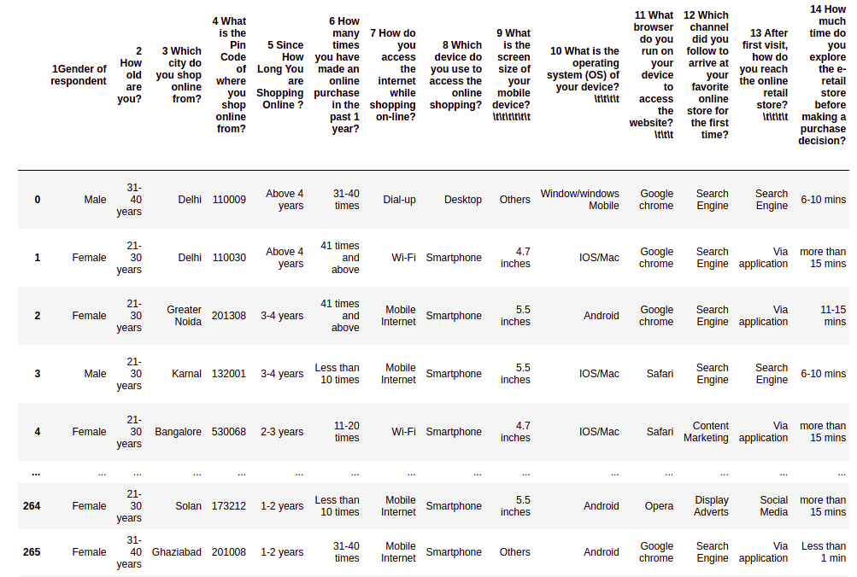

Slide 14
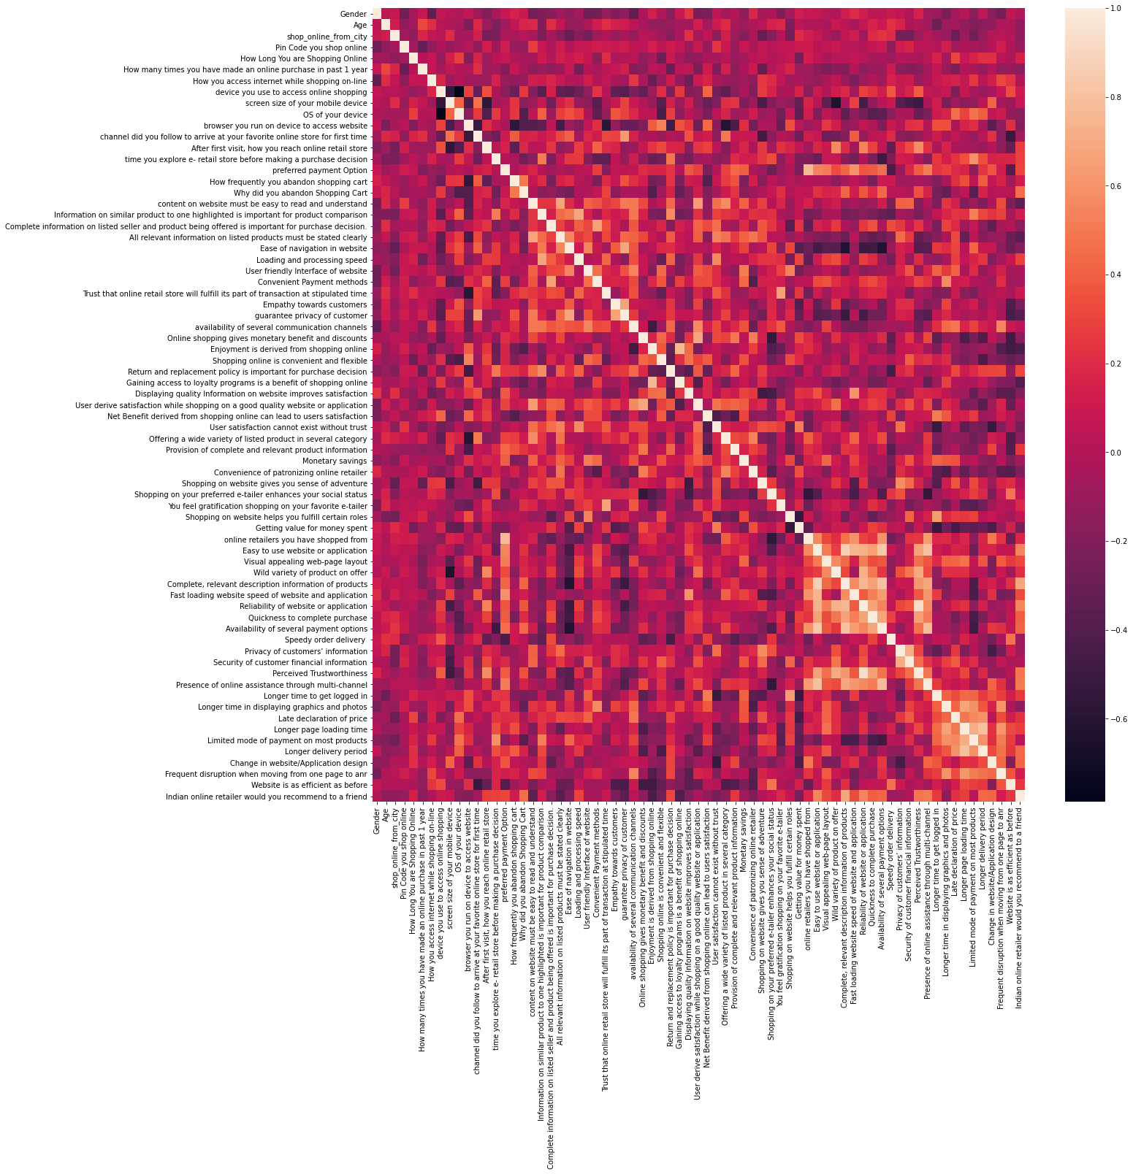
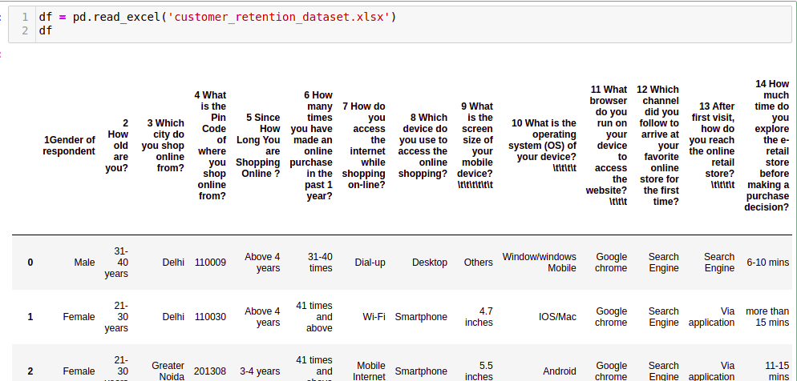
DATA ACQUISITION

Slide 15
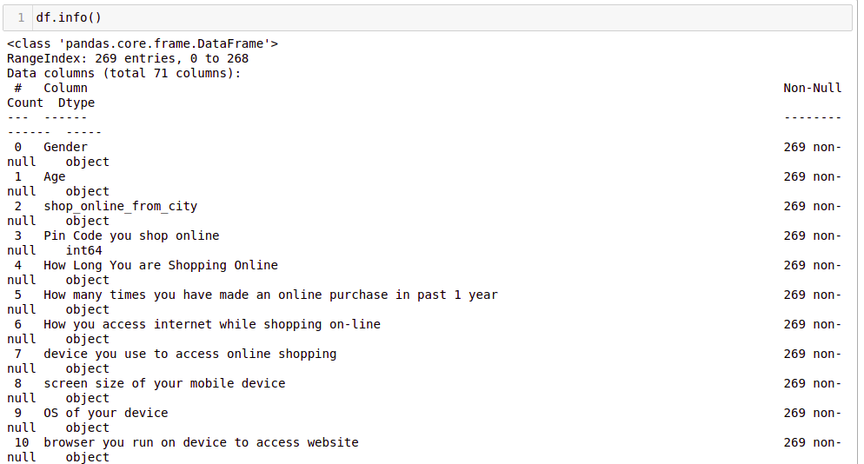
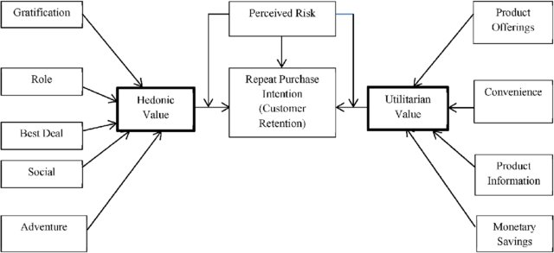
FEATURE DESCRIPTION:
Five major factors that contributed to the success of an e-commerce store have been identified as: service quality, system quality, information quality, trust and net benefit
The left side are Hedonic values and the right side corner values are Utilitarian values. And these values we found in the dataset as attributes. These Attributes contributes as main impactful factors for the Customer Satisfaction and Retention. So our analysis also proved this with more further investigation. And also Found furthermore impactful factors for the E-Retail Business Enhancement.

Slide 16
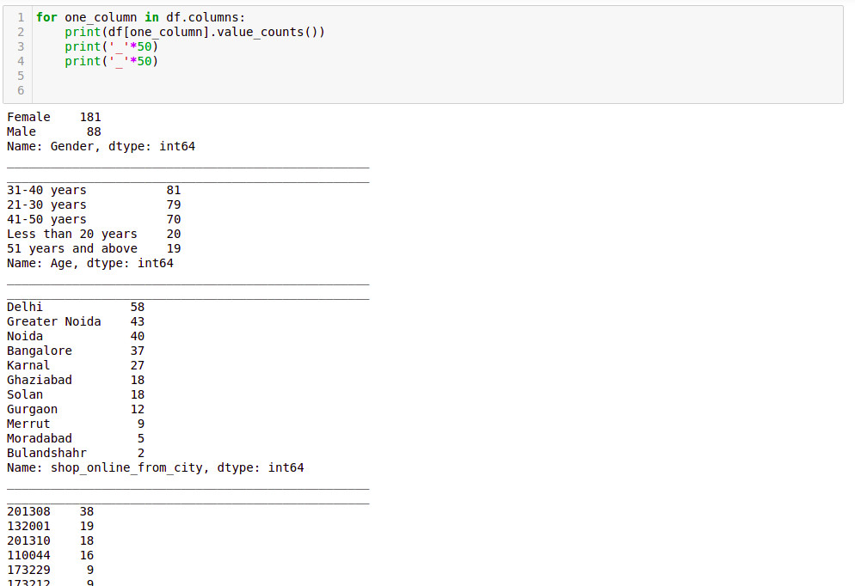
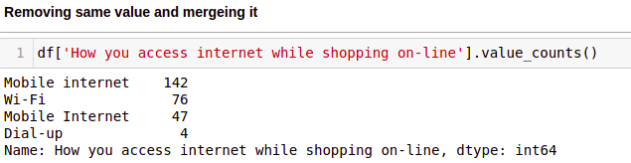
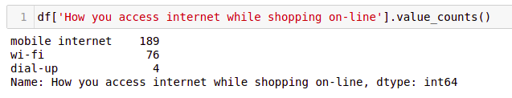
Data Analysis and Pre-peprocessing

Slide 17
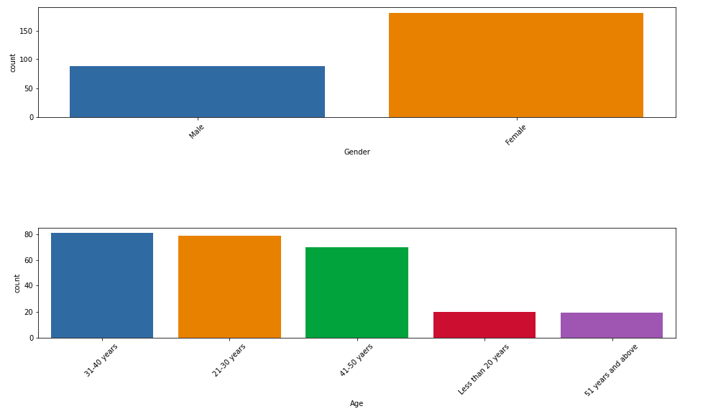
Data Analysis and Preprocessing

Slide 18
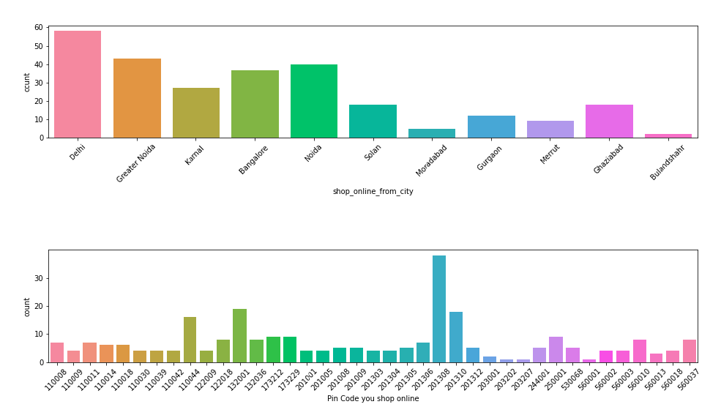

Slide 19
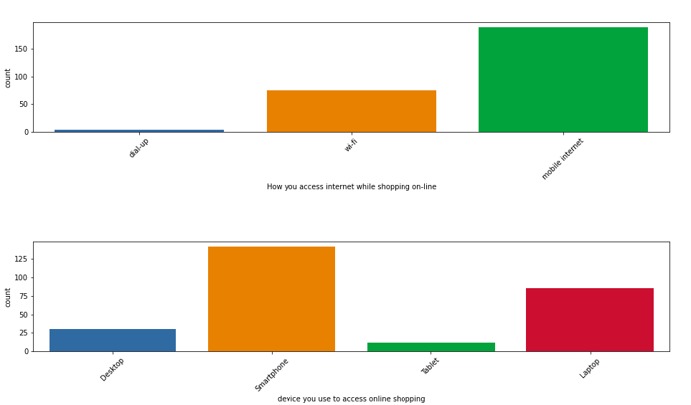

Slide 20
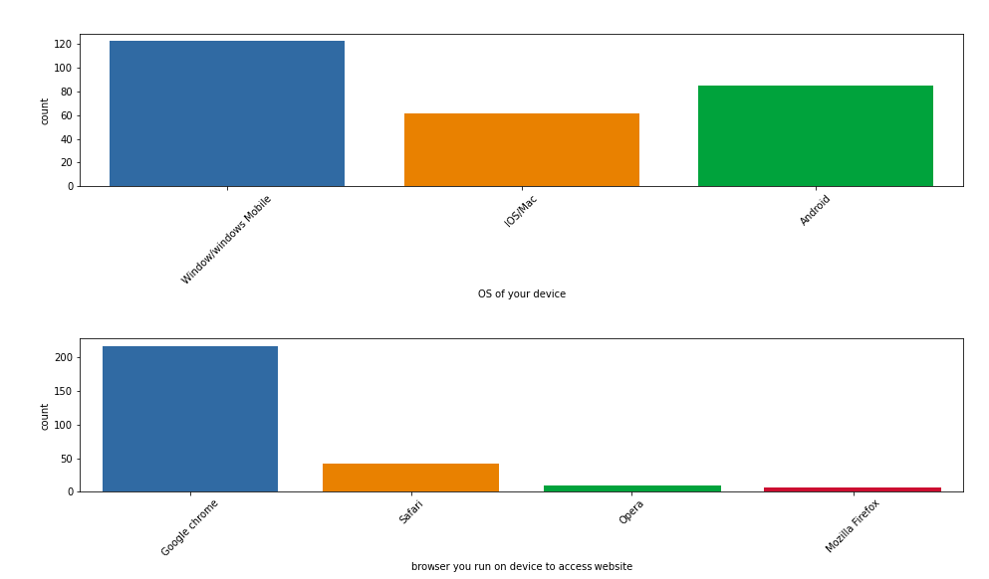

Slide 21
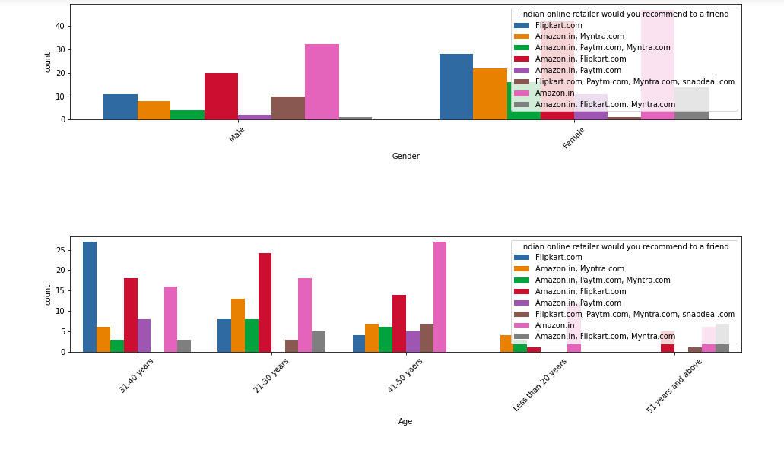

Slide 22
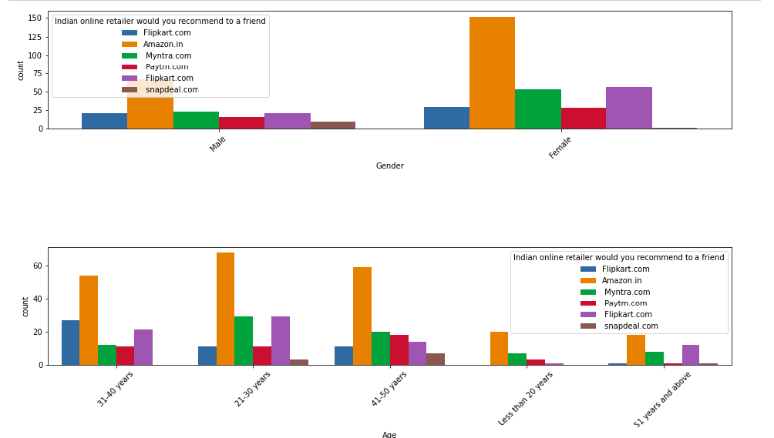

Slide 23
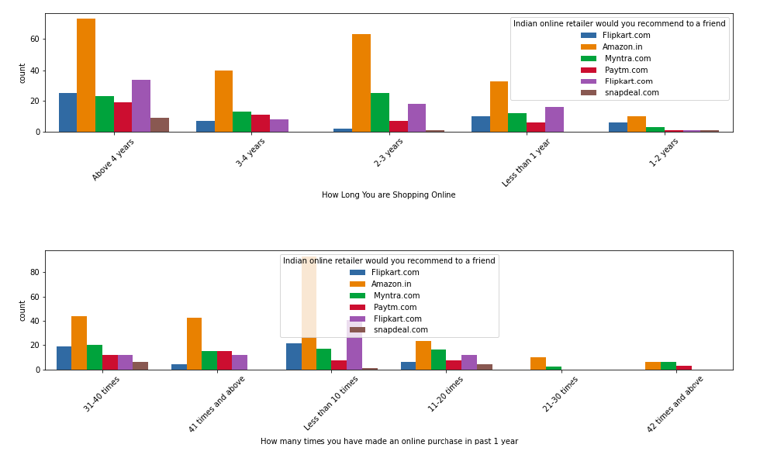

Slide 24
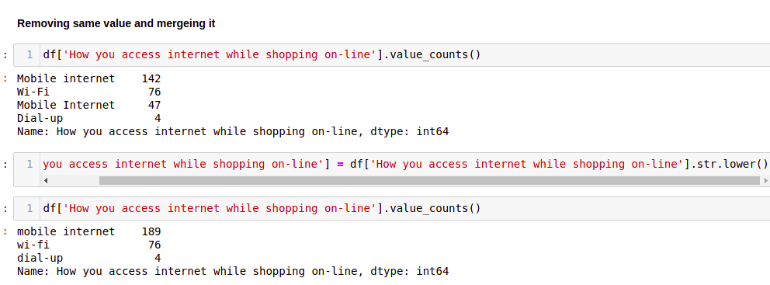
Data Analysis and Pre-processing

Slide 25
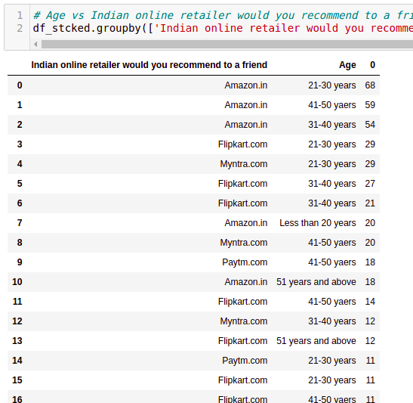
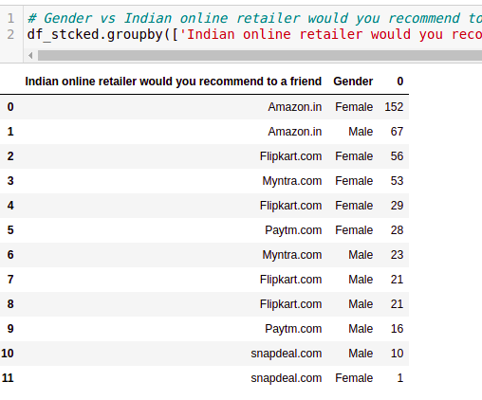
Data Analysis and Pre-processing

Slide 26
Data Inputs- Logic- Output Relationships
In Classification, the output variable must be a discrete value.
In classification, inputs are divided into two or more classes, and the learner must produce a model that assigns unseen inputs to one (or multi-label classification) or more of these classes. This is typically tackled in a supervised way.
In machine learning, classification refers to a predictive modeling problem where a class label is predicted for a given example of input data. A classification model attempts to draw some conclusion from observed values. Given one or more inputs a classification model will try to predict the value of one or more outcomes. The output variables are often called labels or categories.
A classification can have real-valued or discrete input variables. A problem with two classes is often called a two-class or binary classification problem. A problem with more than two classes is often called a multi-class classification problem. A classification algorithm, in general, is a function that weighs the input features so that the output separates one class into positive values and the other into negative values.
Classification is a data mining function that assigns items in a collection to target categories or classes. The goal of classification is to accurately predict the target class for each case in the data. For example, a classification model could be used to identify loan applicants as low, medium, or high credit risks.
Classification analysis is a data analysis task within data-mining, that identifies and assigns categories to a collection of data to allow for more accurate analysis.
Classification analysis can be used to question, make a decision, or predict behaviour through the use of an algorithm.

Slide 27
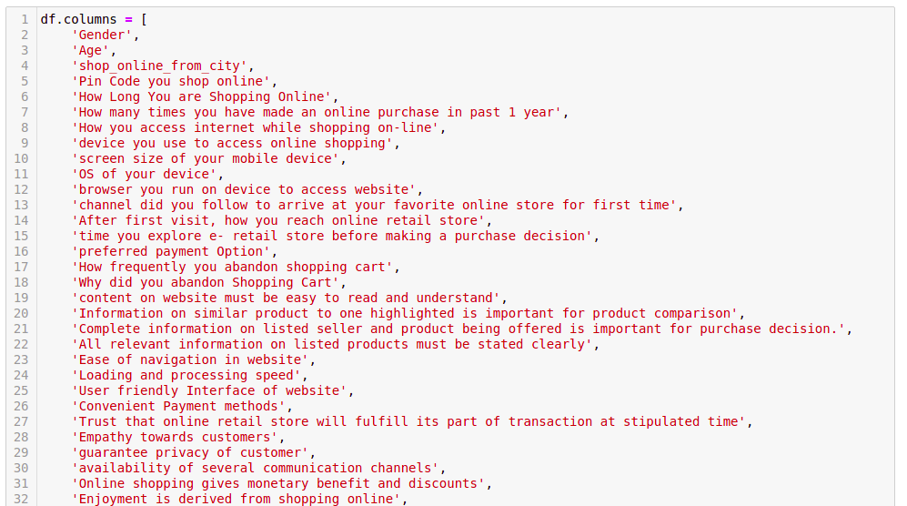
Data Pre-processing & Feature Engineering

Slide 28
Correlation with Heatmap:
The correlation coefficient is a statistical measure of the strength of the relationship between the relative movements of two variables. The values range between -1.0 and 1.0. A calculated number greater than 1.0 or less than -1.0 means that there was an error in the correlation measurement. A correlation of -1.0 shows a perfect negative correlation, while a correlation of 1.0 shows a perfect positive correlation. A correlation of 0.0 shows no linear relationship between the movement of the two variables.Correlation statistics can be used in finance and investing. Pearson correlation is the one most commonly used in statistics. This measures the strength and direction of a linear relationship between two variables.
It can also be defined as the measure of dependence between two different variables. If there are multiple variables and the goal is to find correlation between all of these variables and store them using appropriate data structure, the matrix data structure is used. Such matrix is called as correlation matrix.
Correlation heatmap is graphical representation of correlation matrix representing correlation between different variables.
For to do feature selection and make feature ready for the model building. we check correlation of variables using heatmap.And describe method for the census data set.

Slide 29
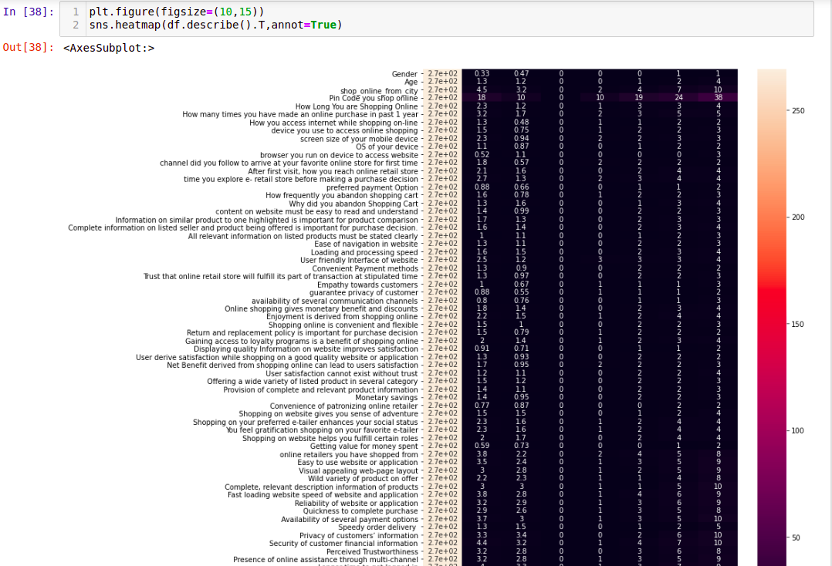
Correlation model: Graph depicts clearly the positive and negative correlation of each variables with target column, justifies the outcome outlined in Multivariate analysis, that higher the education higher the gain & vice-versa

Slide 30
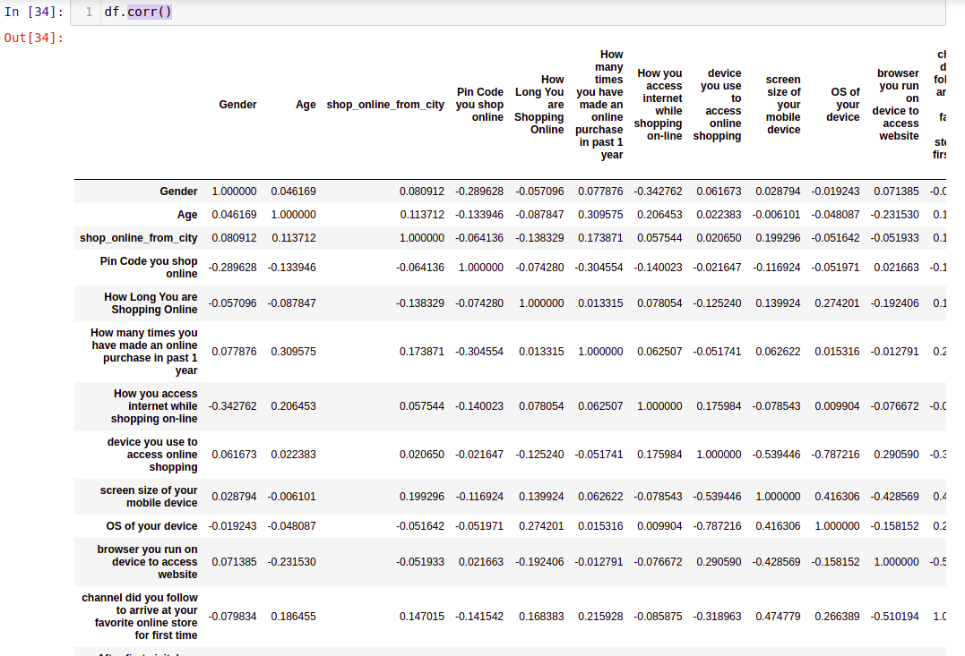
Correlation model:

Slide 31
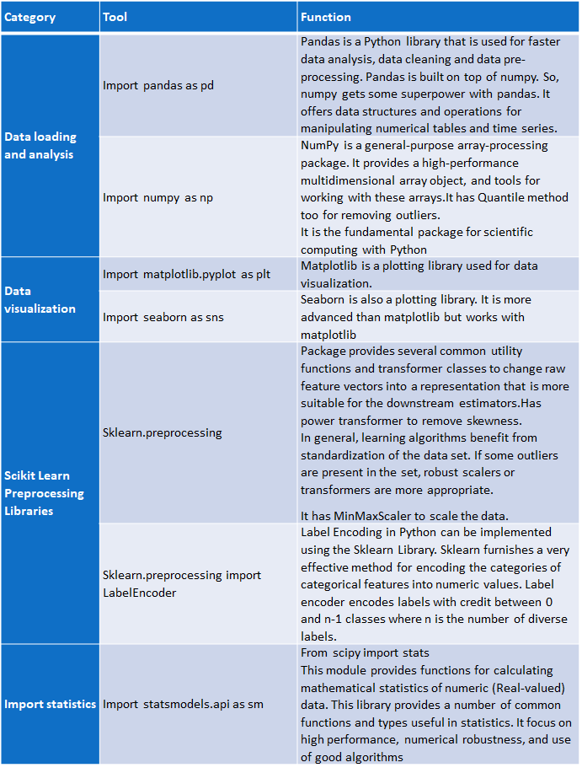
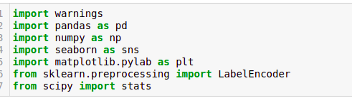
HARDWARE & SOFTWARE TOOLS, LIBRARIES & PACKAGES USED:
Hardware :Intel i7,RAM 16GB used.
Software: Jupyter Notebook (Anaconda 3)
Language: Python
Libraries:
Pandas
Numpy
Matplotlib
Seaborn
Sklean
Scipy
Statsmodels
Pip-Package install Manager

Slide 32
Inferences:
We can see that the amazon.in and flipkart.com are the e-commerce sites that most customer prefers for shopping
Amazon is the most customer friendly, activated and retention website among others
Amazon is the most shopped website among others for years
Amazon is the most shopping website by the customers and they use credit or debit card for the transaction among other payment methods
Customers abandon the purchase before checkout because there are more better alternative offer available. And also the case when the promo code not applicable most of the times
Amazon and Flipkart are doing well in customer retention with hedonic values among other websites
Amazon is doing well in customer retention with utilitatian values among other websites
Top most good customer retention websites are amazon and flipkart
All the utilitarian values are provided mostly by amazon only when compared with others

Slide 33
Limitations of this work and Scope for Future Work:
The biggest drawback of ridge regression is its inability to perform variable selection since it includes all predictor variables in the final model.
Since some predictors will get shrunken very close to zero, this can make it hard to interpret the results of the model.
Handling of multicollinearity with more accuracy can improve the model performance to great extent and can predict any kind of similar datasets with more accurate results.

Slide 34
Key Takeaways
1. There is 71 column and 269 rows
2. In the this Female 181 Male 88
3. Female do more shopping than man
4. Age group of 21-30 and 31-40 do more shopping than others
5. Most of the shopping are done from Delhi itself
6. 201308 Pin code do more shopping then others
7. Most people are shopping form 4 years or more
8. Most people made shopping less than 10 times in year
9. Most of people use mobile internet for shopping
10. Most of the people order from smartphone
11. Most people use chrome browser for shopping
12. Most of people search in search engine to reach the shopping site
13. Most of people explore more than 15 minutes before purchase
14. Most of people order from credit/debit card while paying
15. reason of leaving the cart is because they find other good option
16. Most people Strongly Agree that "Return and replacement" should be there
17. Some People feel lack of trust in flipkart and some didn't found any preferred mode of payment in amazon

Slide 35
CONCLUSION
Key Findings and Conclusions of the Study:
Customer Satisfaction and Retention can be improved by concentrating on the above mentioned hedonic and utilitarian values. And it can be attained by concentrating on the following impactful factors such as
Getting value for money spent Loading and processing speed User satisfaction cannot exist without trust The Convenience of patronizing the online retailer Privacy of customers’ information Quickness to complete purchase You feel gratification shopping on your favorite e-retailer Longer time in displaying graphics and photos (promotion, sales period)', Late declaration of price (promotion, sales period) Monetary savings Frequent disruption when moving from one page to another
Five major factors that contributed to the success of an e-commerce store have been identified as: service quality, system quality, information quality, trust and net benefit

Slide 36
Learning Outcomes of the Study in respect of Data Science
From the above models Random Forest Classifier performs well. Because, The random forest is a classification algorithm consisting of many decisions trees. It uses bagging and feature randomness when building each individual tree to try to create an uncorrelated forest of trees whose prediction by committee is more accurate than that of any individual tree. So we save this model for prediction
We faced multi col-linearity issue because too many features in the dataset. Eventhough the number of features after reduced from 71 to 65.we still face multicollinearity issue. So we used PCA technique to overcome this And also Random-Forest Classifier because it handles the problem of multicollinearity very well. Random Forest uses bootstrap sampling and feature sampling, i.e row sampling and column sampling. Therefore Random Forest is not affected by multicollinearity that much since it is picking different set of features for different models and of course every model sees a different set of data points.
Correlated features will be given equal or similar importance, but overall reduced importance compared to the same tree built without correlated counterparts. Random Forests and decision trees, in general, give preference to features with high cardinality ( Trees are biased to these type of variables.
And also It reduces over-fitting problem in decision trees and also reduces the variance and therefore improves the accuracy.
Thus this Random Forest Classifier Model performs well for this dataset.so we saved this model.

Slide 37
Limitations of this work and Scope for Future Work
The main limitation of random forest is that a large number of trees can make the algorithm too slow and ineffective for real-time predictions.
In general, these algorithms are fast to train, but quite slow to create predictions once they are trained.
For very large data sets, the size of the trees can take up a lot of memory. It can tend to over-fit, so you should tune the hyper-parameters
Here we used PCA to project the data into a new space where the 'new features' will be orthogonal to each other. We then, trained the model with the new features, but we found that the performance is the same. so we must You simply rotate original decision boundary to overcome this limitation in future and try with the same model.

Slide 38
Thanks

